Slide 1



HistoryCipher

Slide 2
HistoryCipher

Slide 3
Table of Contents
01
02
Our Team
Our Idea
03
Technologies Used

Slide 4
01
Our Team

Slide 5
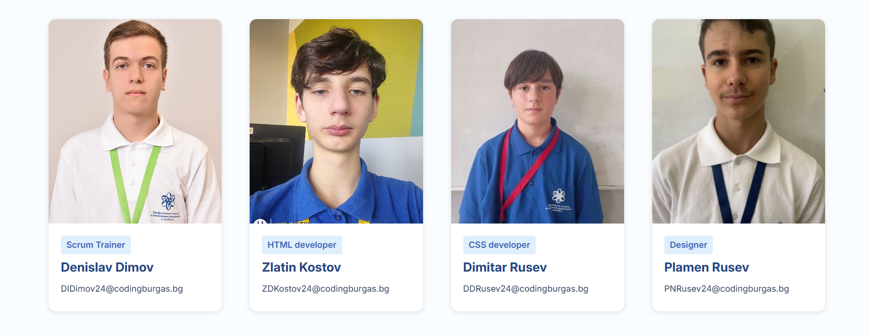
Our Team

Slide 6
02
Our Idea

Slide 7

Our Idea
The general idea of our project is a car rental website offering a small selection of vehicles, transparent pricing, and convenient booking for customers.

Slide 8
03
Technologies used

Slide 9








Technologies used

Slide 10
Thanks for your time!

